Slide 1

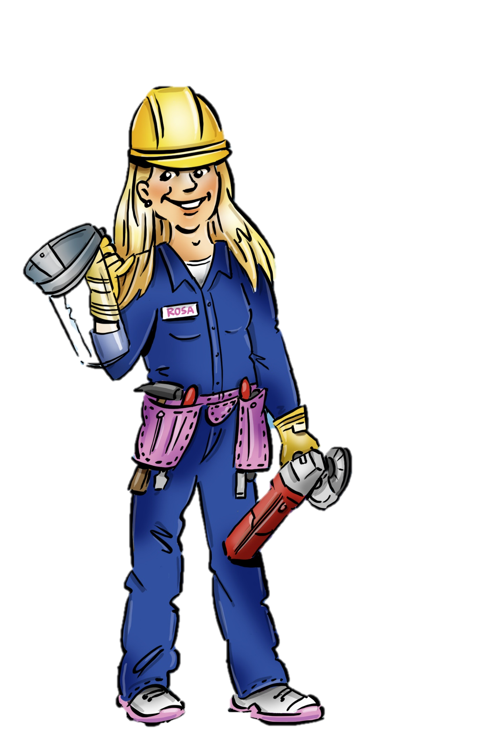
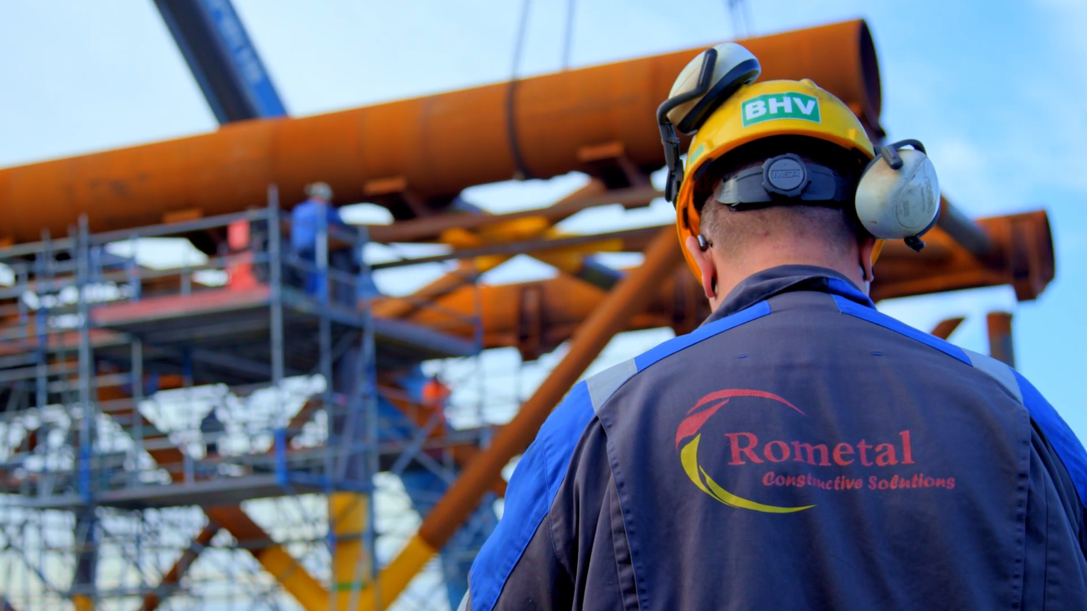
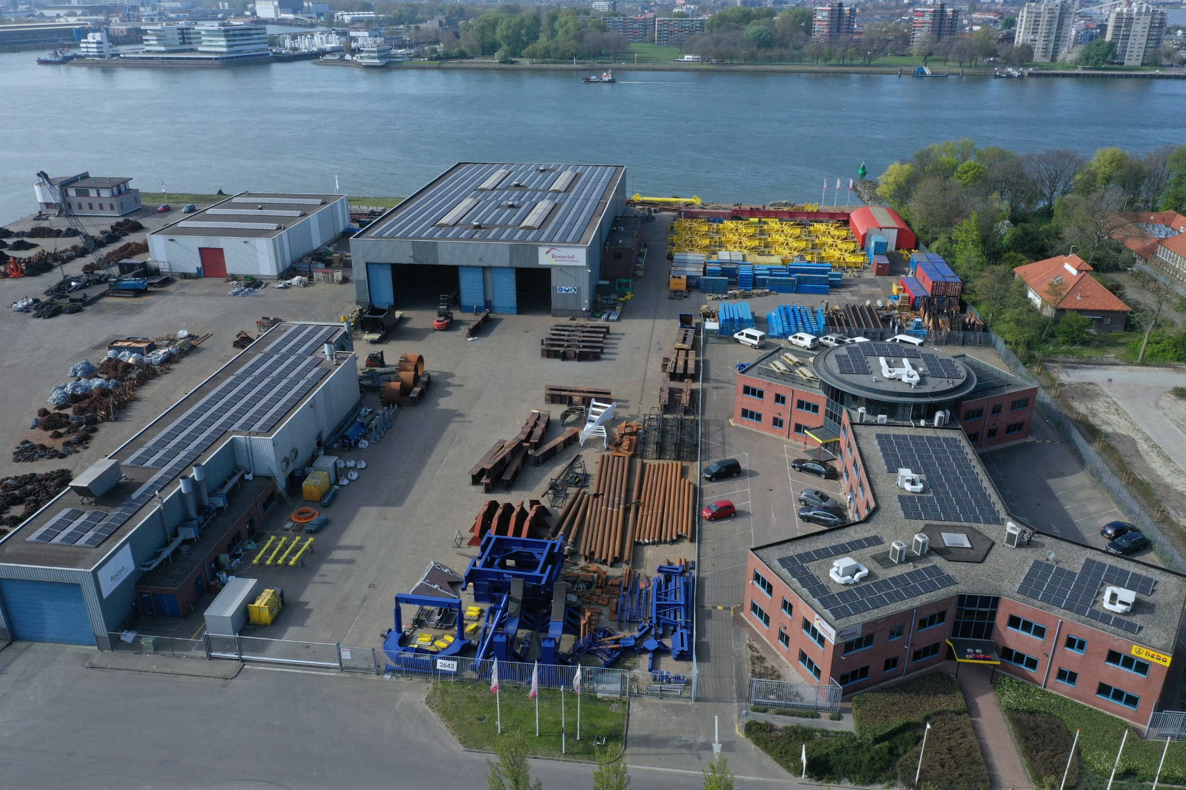
Safety Induction
Hi, nice to meet you!
My name is Rosa.
I would like to give you the safety induction
to have a safe visit
at Rometal.
START 🡪

Slide 2


Slide 3


Parking spaces are available
around the building.

Slide 4

Please be mindful of your speed
on the premises.

Slide 5
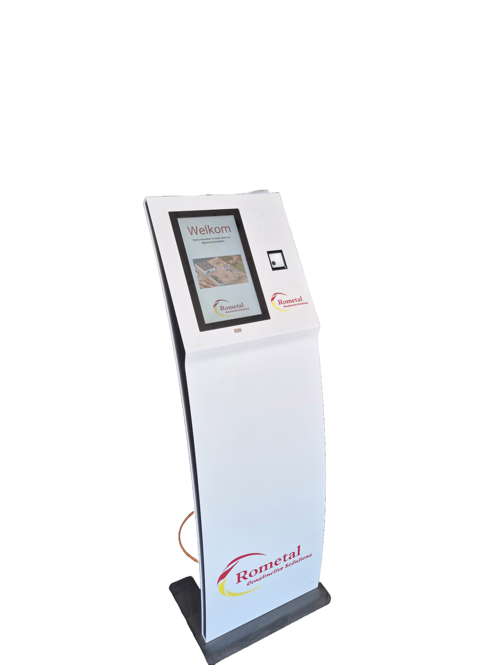

Upon your arrival at Rometal, please report
to your contact person using the check-in kiosk.

Slide 6

Beware of forklifts and other vehicles!

Slide 7


Assembly point in case of emergency.

Slide 8

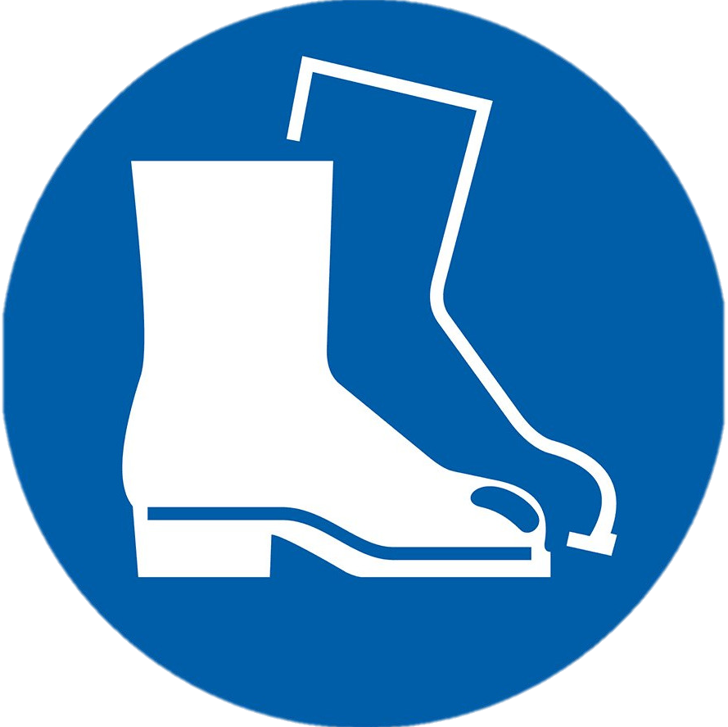



You are required to wear
these PPE where indicated.

Slide 9
The yard
In the yard you are
required to wear these PPE.

Slide 10
The yard
Safety glasses are only required when construction work is being carried out in the yard.

Slide 11
The yard
GREEN ZONE =
PPE FREE ZONE
The green zone near the workplace of Rocon is a PPE free zone.

Slide 12
Workplace Rometal
In the workplace of Rometal you are
always required to wear these PPE.

Slide 13
Workplace Rometal
Hearing protection is also required when noise levels exceed 85 decibels.

Slide 14
Workplace Rocon
In the workplace of Rocon you are
required to wear these PPE.

Slide 15
Workplace Rocon
Safety glasses are also mandatory for specific tasks.

Slide 16
Workplaces
Stay on the designated walkways unless you need to access a construction.
Possible hazards
Hot work
Lifting
Tripping hazard
Working at hights (change of falling objects)
Do not look into the blue light while welding.
In the workplace, pay attention to the following points and hazards.

Slide 17

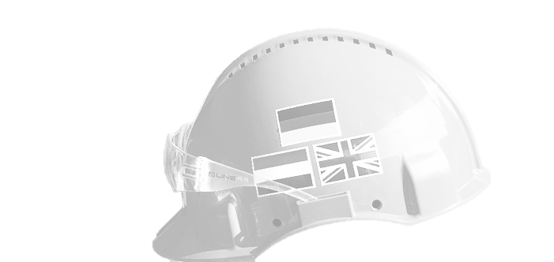


Safety Induction
SHARP
BHV / First Aid

Slide 18
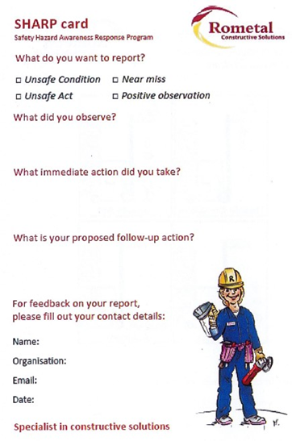

Safety Induction
Help us to improve the safety, health and environment.
Communication languages
BHV
SHARP

Slide 19
Safety Induction
Communication languages
The helmet indicates if someone is
BHV / First Aid.
SHARP
BHV / First Aid

Slide 20
Safety Induction
Thank you for your attention!
Please return to our webstite to finish your induction.
Have a safe visit at Rometal!

